Slide 1
LDA on Spark MLlib
Ahmed Abdulrahman

Slide 2
Agenda
Basics & Related Concepts
Introduction to LDA
Adding LDA to Spark MLlib
How LDA will be Distributed
LDA Results
Next Step
References

Slide 3
Basics & Related Concepts
1

Slide 4
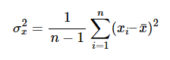
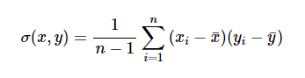
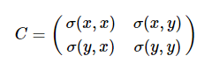
Covariance Matrix (1)
Variance measures the variation of a single random variable
covariance is a measure of how much two random variables vary together
The covariance σ(x,y) of two random variables x and y is given by:
the covariance matrix is symmetric and square
The diagonal entries of the covariance matrix are the variances and the other entries are the covariance

Slide 5
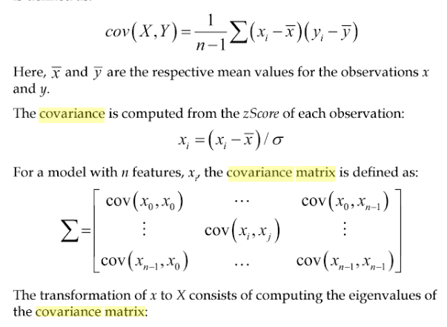
Covariance Matrix (2)

Slide 6
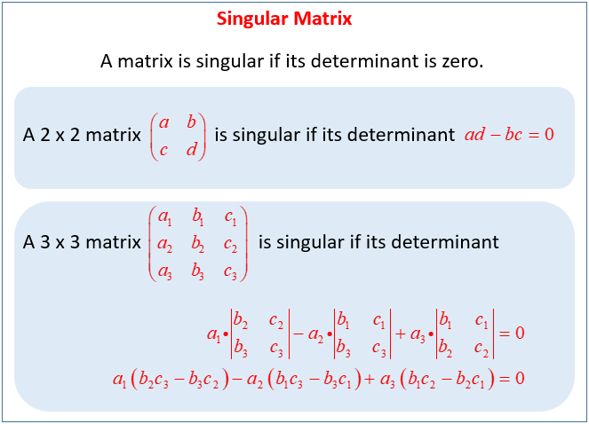
Singular Matrix
Singular Matrix is a square matrix that does not have a matrix inverse.
A matrix is singular if and only if its determinant is 0
Singular matrices are unique and cannot be multiplied by any other matrix to get the identity matrix

Slide 7
Covariance inverse & Multi-collinearity
Collinearity is a linear association between two explanatory variables. Two variables are perfectly collinear if there is an exact linear relationship between them.
Multi-collinearity refers to a situation in which two or more explanatory variables in a multiple regression model are highly linearly related. We have perfect multi-collinearity if, for example as in the equation above, the correlation between two independent variables is equal to 1 or −1.
In practice, we rarely face perfect multi-collinearity in a data set. More commonly, the issue of multi-collinearity arises when there is an approximate linear relationship among two or more independent variables.

Slide 8
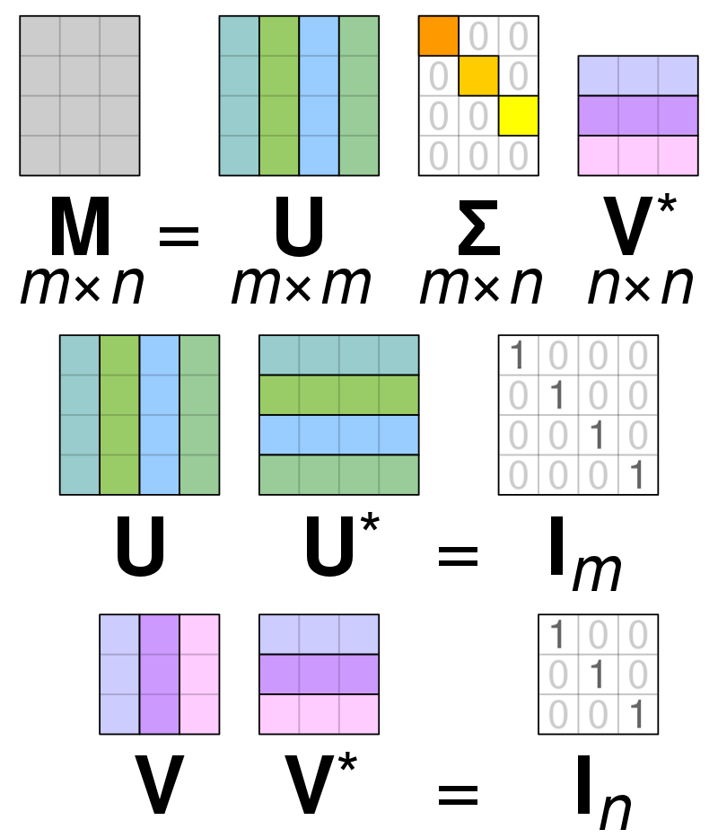
Singular Value Decomposition (SVD)
In linear algebra, the singular-value decomposition (SVD) is a factorization of a real or complex matrix.
The singular value decomposition of a matrix is a sort of change of coordinates that makes the matrix simple, a generalization of diagonalization.
Formally, the singular-value decomposition of an m x n real or complex matrix M is a factorization of the form shown in graph ->
Applications that employ the SVD include computing the pseudoinverse, least squares fitting of data, multivariable control, matrix approximation, and determining the rank, range and null space of a matrix.
https://www.youtube.com/watch?v=_4jaLZCoLPI&t=32s

Slide 9
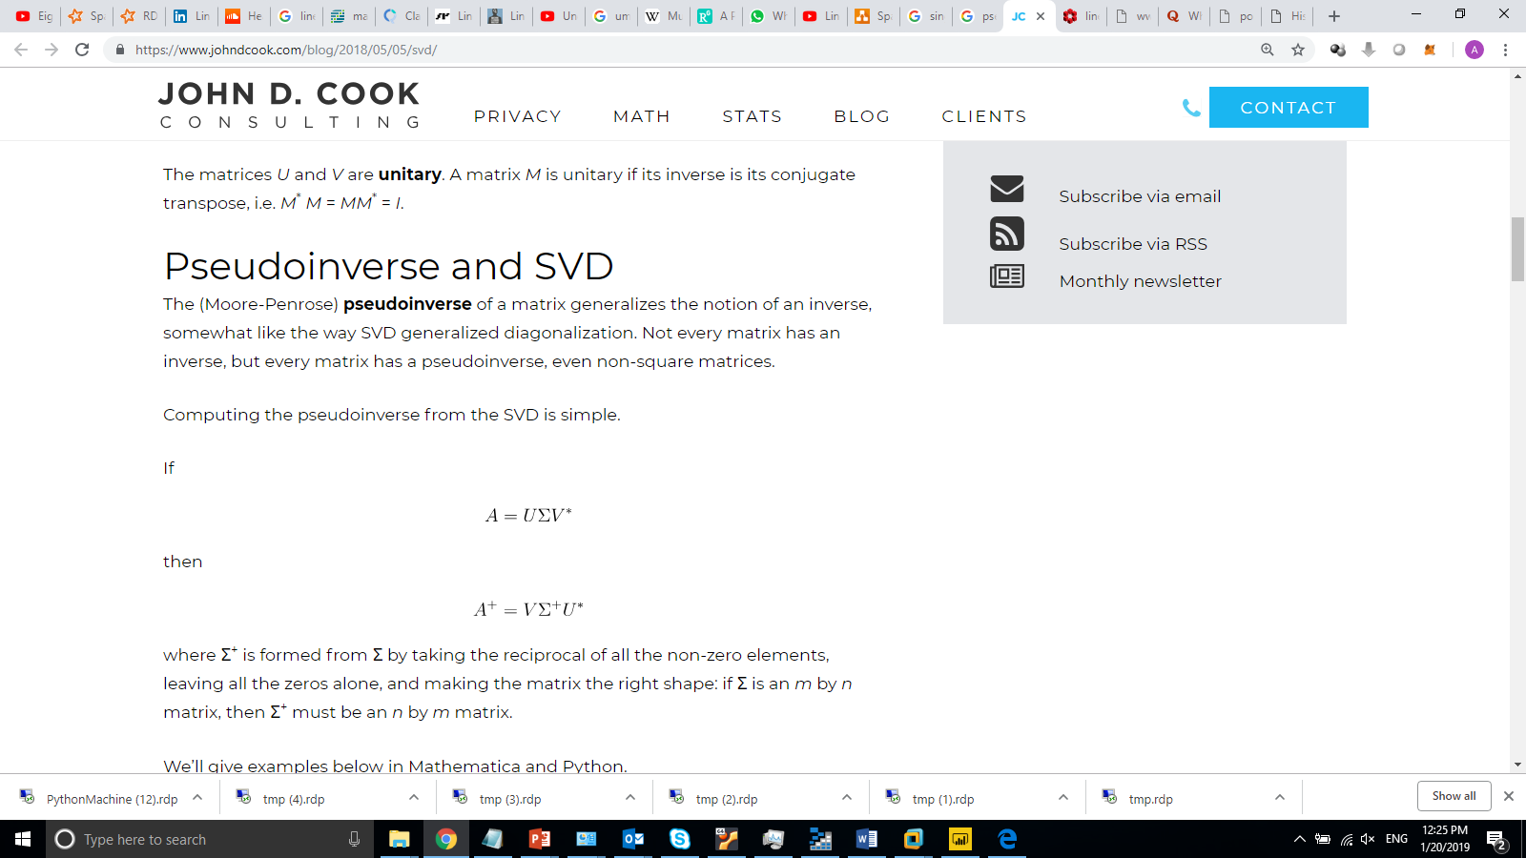
Matrix Pseudoinverse
Not every matrix has an inverse, but every matrix has a pseudoinverse, even non-square matrices.
where Σ⁺ is formed from Σ by taking the reciprocal of all the non-zero elements, leaving all the zeros alone, and making the matrix the right shape: if Σ is an m by n matrix, then Σ⁺ must be an n by m matrix.
A common use of the pseudoinverse is to compute a 'best fit' (least squares) solution to a system of linear equations that lacks a unique solution . Another use is to find the minimum (Euclidean) norm solution to a system of linear equations with multiple solutions

Slide 10
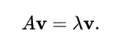
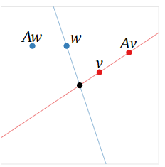
Eigen Vectors and Eigen Value
The German prefix “Eigen” roughly translates to “self” or “own”. An eigenvector of A is a vector that is taken to a multiple of itself, which partially explains the terminology.
In linear algebra, an eigenvector of a linear transformation is a non-zero vector that changes by only a scalar factor when that linear transformation is applied to it.
to have matrix multiplication be the same as just multiplying the vector by a constant.
Eigenvalues and eigenvectors are only for square matrices.
To say that Av=λv means that Av and λv are collinear with the origin. So, an eigenvector of A is a nonzero vector v such that Av and v lie on the same line through the origin. In this case, Av is a scalar multiple of v; the eigenvalue is the scaling factor.

Slide 11
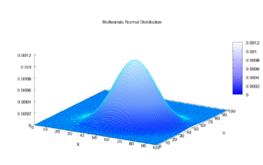
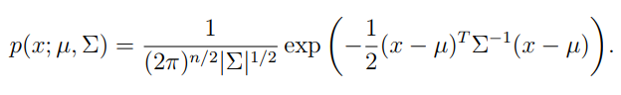
Multivariate Gaussian Distribution
In probability theory and statistics, the multivariate normal distribution, multivariate Gaussian distribution, or joint normal distribution is a generalization of the one-dimensional (univariate) normal distribution to higher dimensions.
One definition is that a random vector is said to be k-variate normally distributed if every linear combination of its k components has a univariate normal distribution.

Slide 12
Introduction to LDA
2

Slide 13
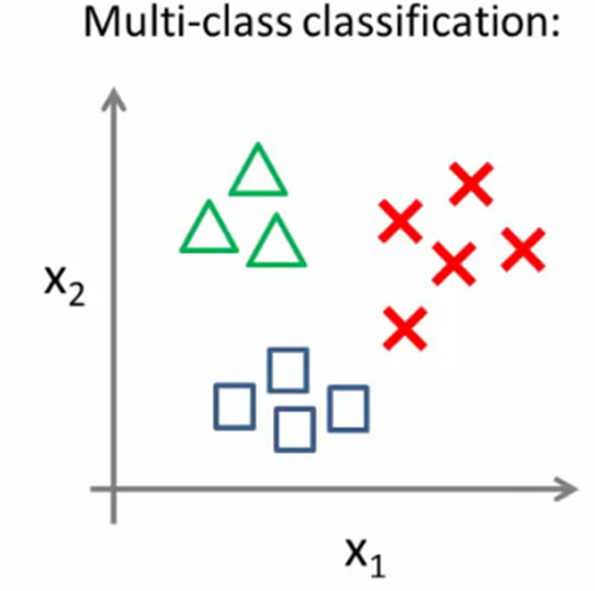
Introduction to LDA
LDA (Linear Discriminant Analysis) is a known dimension reduction and classification approach.
Linear discriminant analysis (LDA) relies on the sample mean and covariance matrices computed from different groups from the training sample.
LDA makes predictions by estimating the probability that a new set of inputs belongs to each class. The class that gets the highest probability is the output class and a prediction is made
LDA is based upon the concept of searching for a linear combination of features that best separate classes.

Slide 14
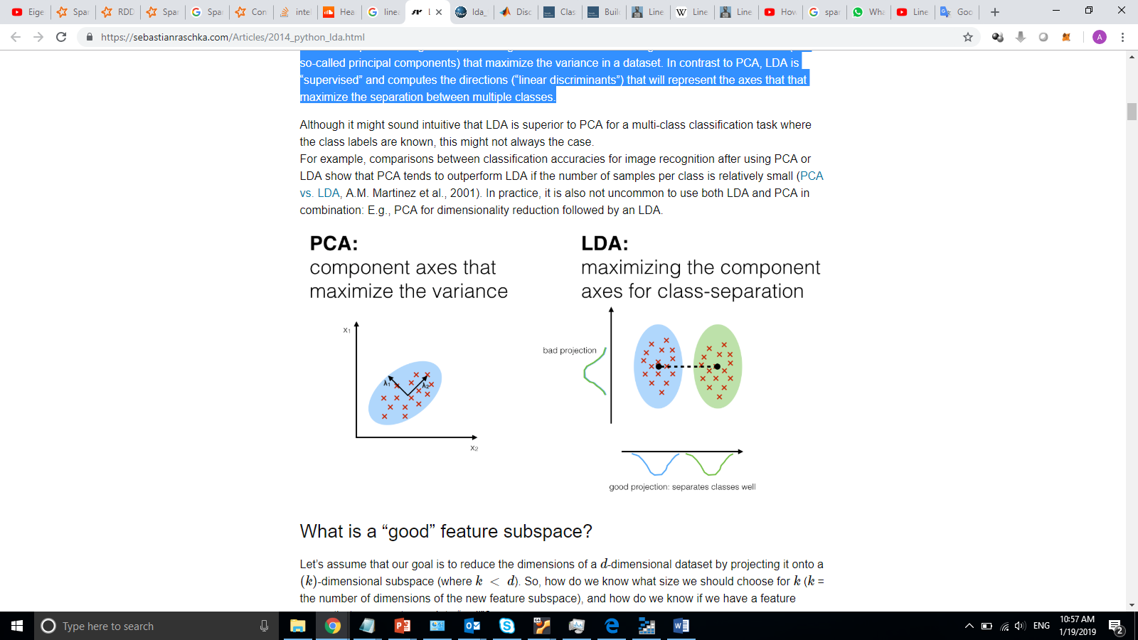
LDA vs PCA
Both Linear Discriminant Analysis (LDA) and Principal Component Analysis (PCA) are linear transformation techniques that are commonly used for dimensionality reduction.
PCA can be described as an “unsupervised” algorithm, since it “ignores” class labels and its goal is to find the directions (the so-called principal components) that maximize the variance in a dataset. In contrast to PCA.
LDA is “supervised” and computes the directions (“linear discriminants”) that will represent the axes that that maximize the separation between multiple classes.

Slide 15
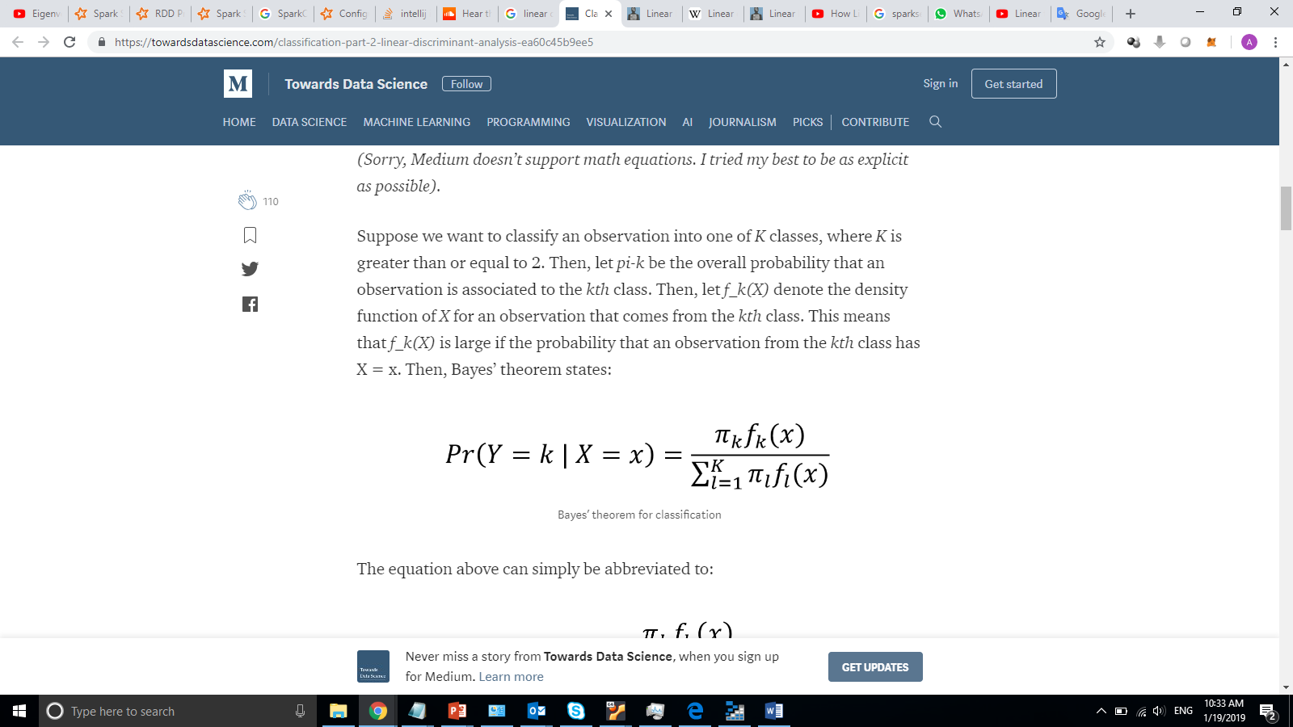
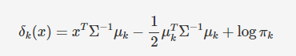
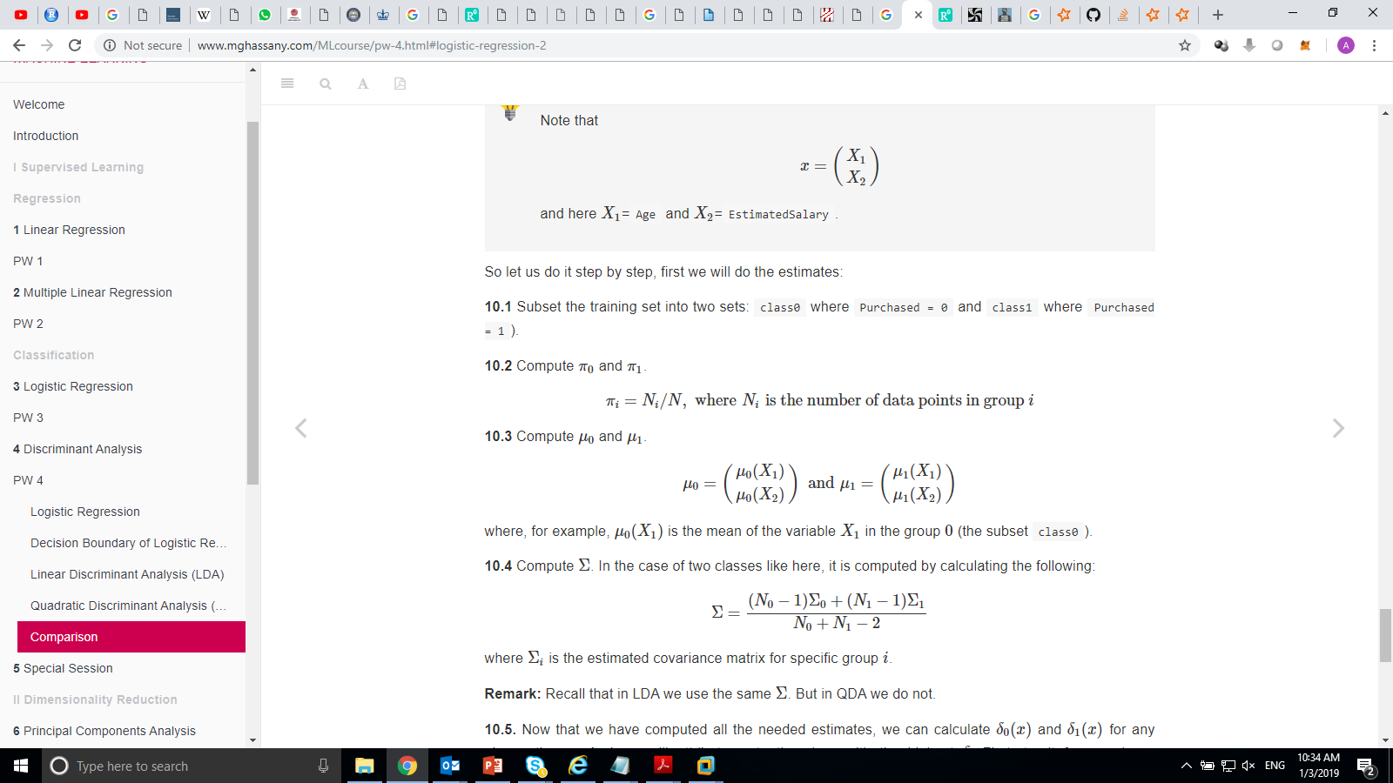
How LDA Work?
LDA makes predictions by estimating the probability that a new set of inputs belongs to each class. The class that gets the highest probability is the output class and a prediction is made
The challenge here is to estimate the density function
we must assume that X is drawn from a multivariate Gaussian distribution, with a class-specific mean vector, and a common covariance matrix

Slide 16
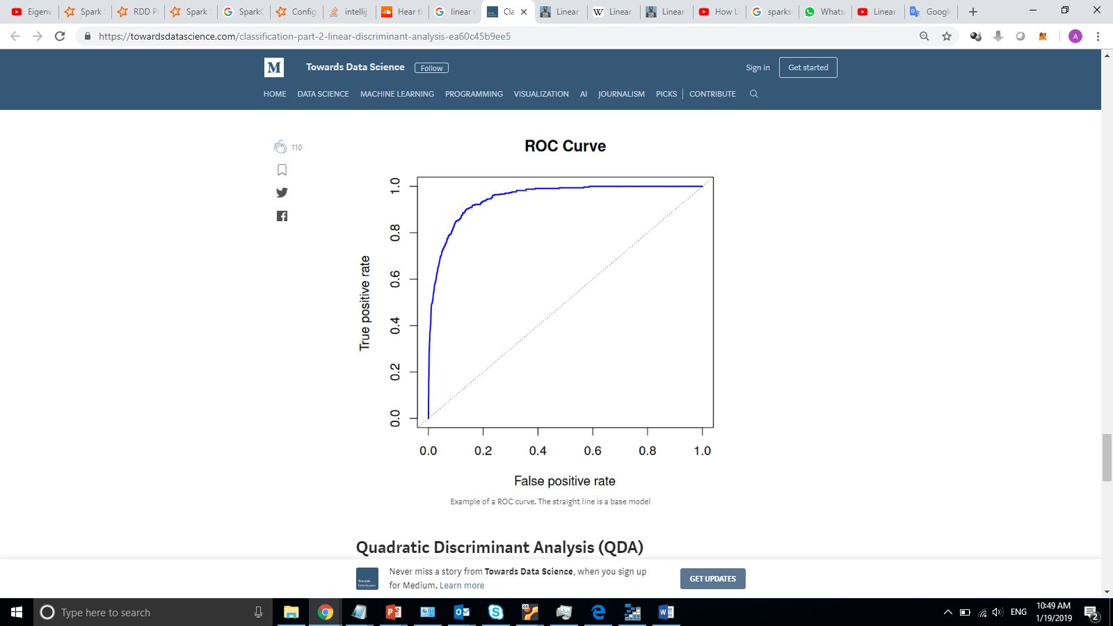
Measure LDA Performance
With classification, it is sometimes irrelevant to use accuracy to assess the performance of a model.
Usually, we use sensitivity and specificity.
Sensitivity is the true positive rate: the proportions of actual positives correctly identified.
Specificity is the true negative rate: the proportion of actual negatives correctly identified.
The ROC curve (receiver operating characteristic) is good to display the two types of error metrics described above. The overall performance of a classifier is given by the area under the ROC curve (AUC)

Slide 17
Adding LDA to Spark MLlib
3

Slide 18
LDA Classes and Traits
Spark MLlib algorithms implementation Exists in two packages ( ML & MLlib)
I have added LDA implementation to ML, however still using some MLlib classes (ex: distributed Matrix) since it is not implemented in ML.
All ML & MLlib Algorithms consists mainly of four parts:
Estimator : Learn from data and produce the Model
Transformer : the model that able to classify data
Parameters :Algorithm needed parameters
Model Reader & Writer : responsible for reading and writing the model to the storage
May be some helper functions and structure used too

Slide 19
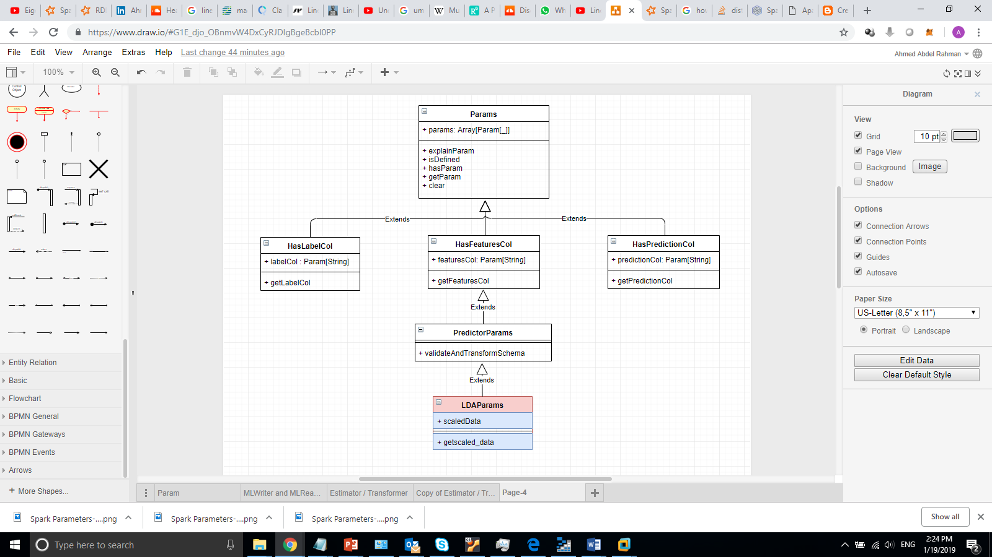
LDA PARAMS
It used to provide Parameter name, description, default value ,….
It inherit from PredictorParams
The parameter class provide the flowing parameters:
predictionCol: prediction column name
labelCol: label column name
featuresCol: features column name
scaledData: is the data need to be scaled or not?

Slide 20
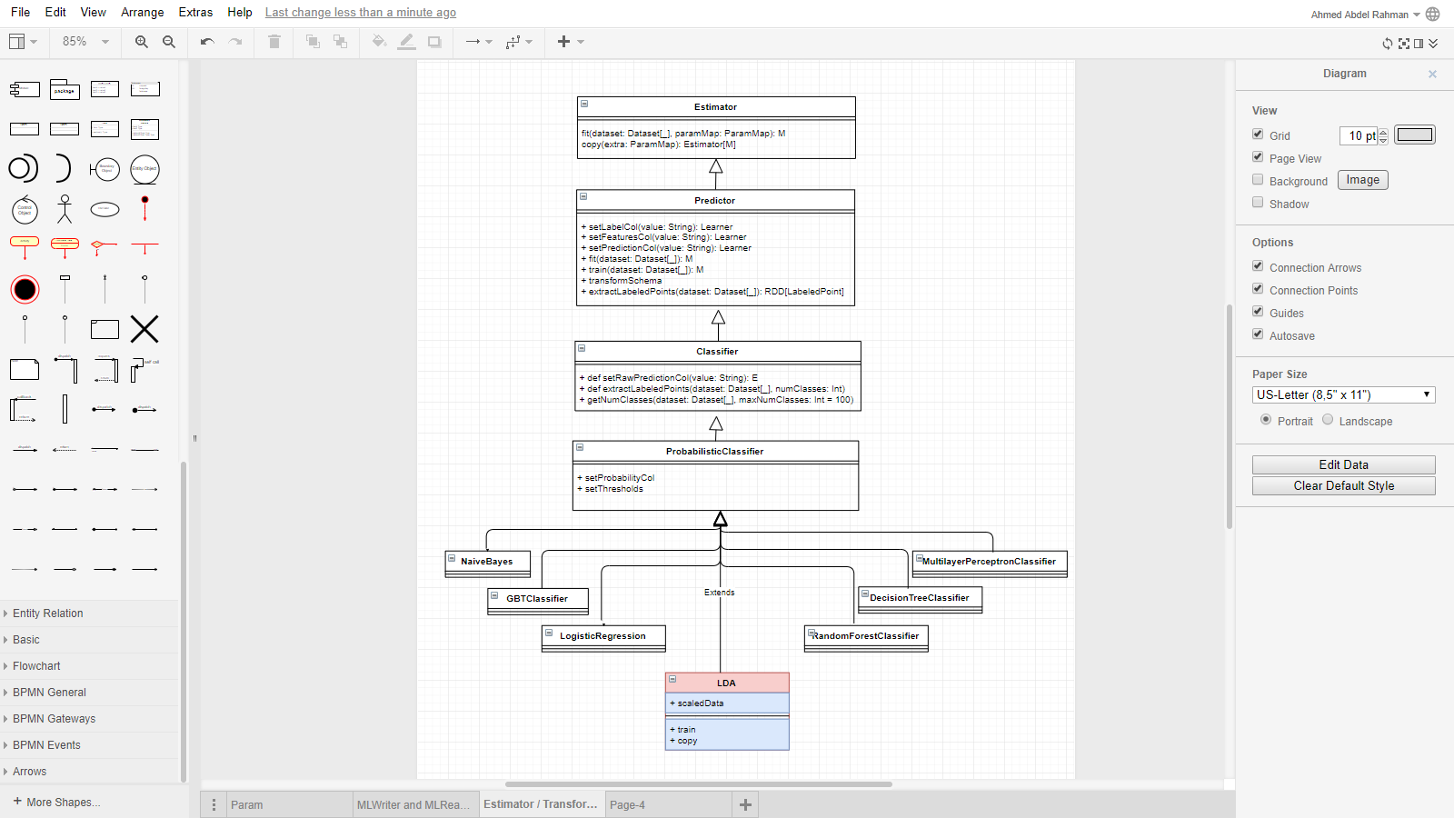
LDA Algorithms
Take input as a dataset of Label and vector of features
Inherit directly from ProbabilisticClassifier like other classifier (Naïve Bayes, Logistic Regression, Random Forest, ….)
Implement the training function that produce a model as an output
At the end it is a Spark Estimator that run to produce a Transformer as an output
It use LDA PARAMS to get the algorithm hyper - Parameters

Slide 21
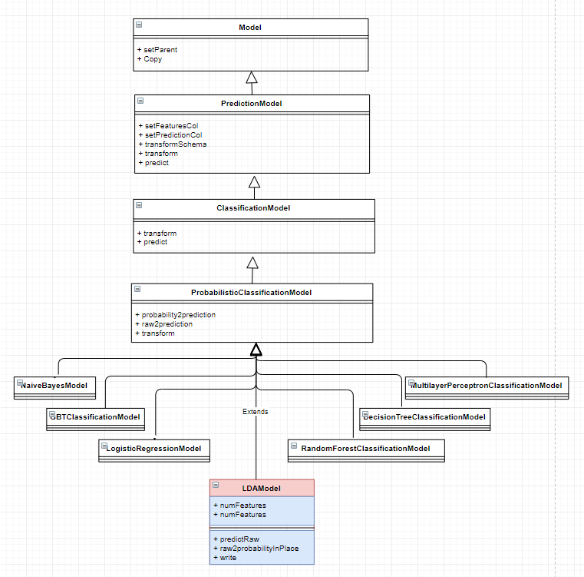
LDA Model
It is the resulted Model that we will use to classify and predict data.
It is a Transformer
Inherit from ProbabilisticClassificationModel
It receives dataset and transform it (add new column for the predicted label and probability)
Mainly override two functions (predictRaw & raw2probabilityInPlace )

Slide 22
LDA Distribution
4

Slide 23
LDA Training Process
LDA need to calculate Statistics about the Dataset to be able to generate the model.
Mainly we need to calculate:
Mean and Count per Class
Covariance Matrix per Class
Pooled Covariance Matrix
Transpose and Inverse for (Mean & Covariance Matrices)
In case of big Data some calculation will be a challenge and will take a lot of processing time but on the other hand not every thing can be distributed

Slide 24
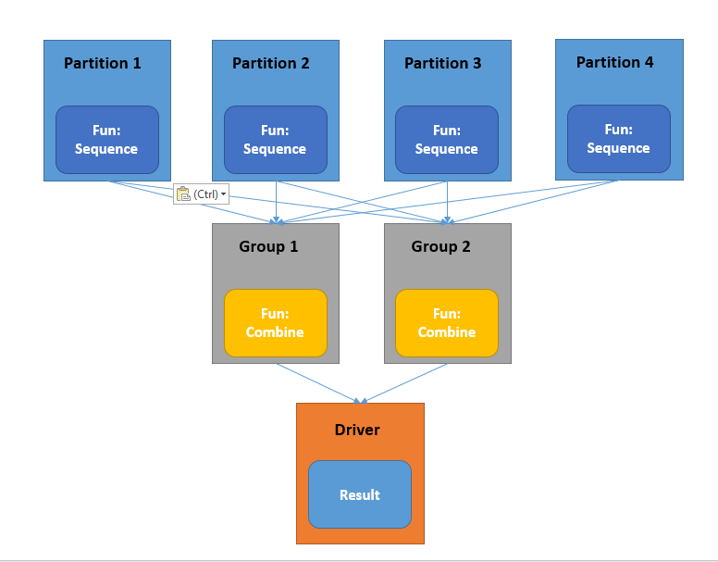
LDA Aggregation Distribution
In order to calculate (mean vector and count of instances) per each class I am using AggregateByKey function
Sequence function work per partition to calculate the count and sum per class to minimize the need of shuffle a lot of data and to work on parallel too
Combine function work across partitions to aggregate the aggregated data then move the result to the driver which will be a vector for each class
the size of that vector equal to the number of features

Slide 25
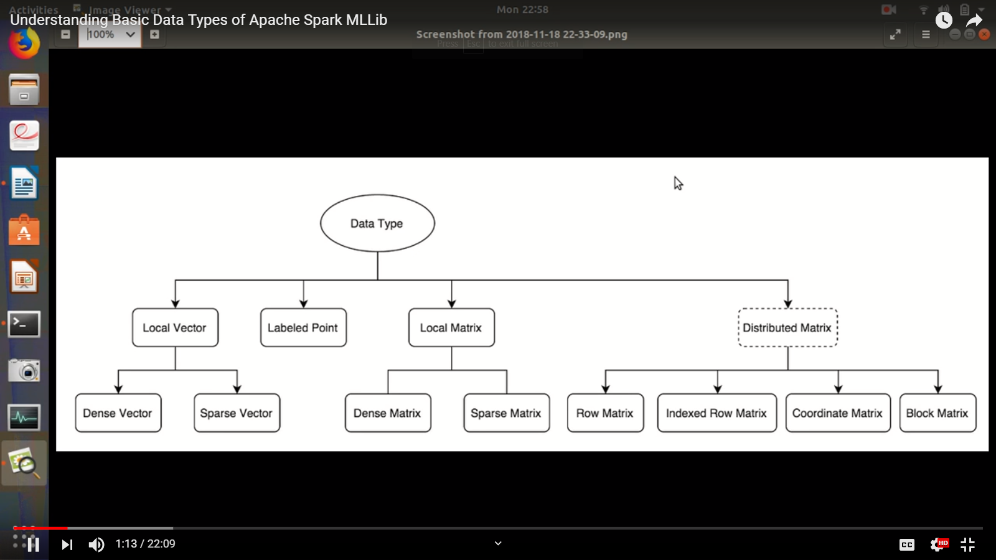
LDA Matrices Operation
MLlib supports local vectors and matrices stored on a single machine, as well as distributed matrices backed by one or more RDDs.
I have used the distributed Matrix to calculate the covariance matrix for each class
The result will be a square matrix d x d ( where d is the number of the dimension)
I have used Distributed matrix also to calculate Singular value Decomposition of the covariance matrix in order to get the inverse of the covariance matrix.

Slide 26
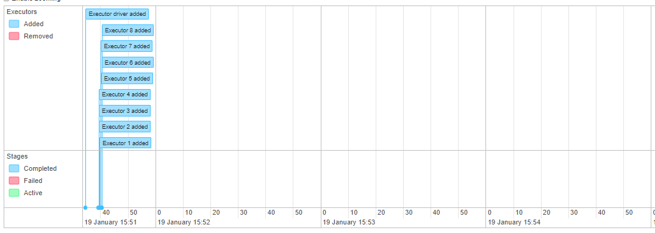
Distributing jobs from Train Function (1)
I have tested the model on 8 worker nodes cluster, each node has 4 core processor.

Slide 27
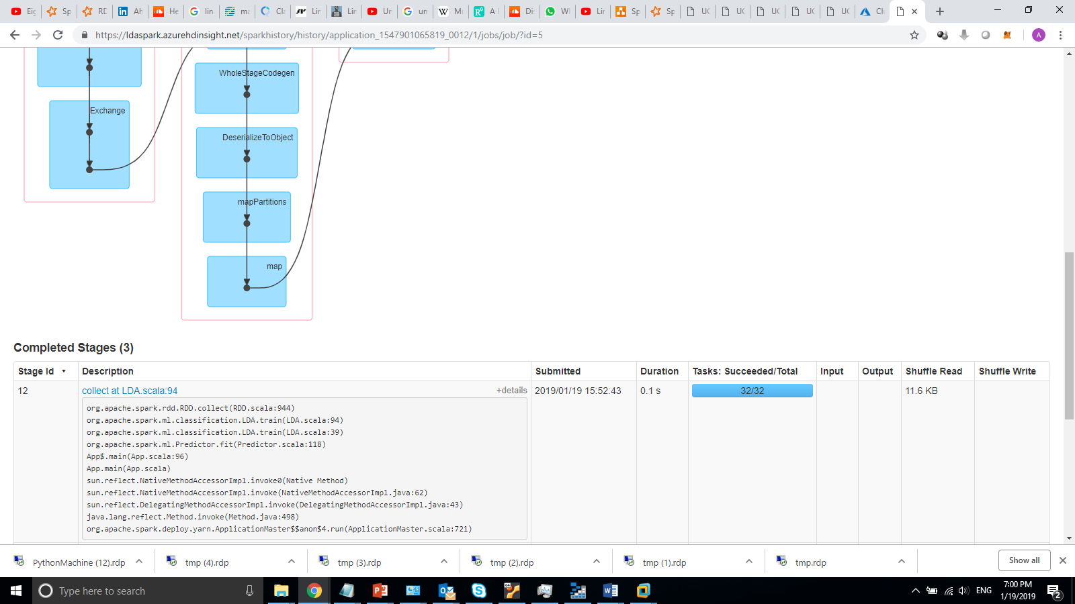
Distributing jobs from Train Function (2)
32 tasks (4 cores X 8 Executers) – 32 partitions processed in parallel

Slide 28
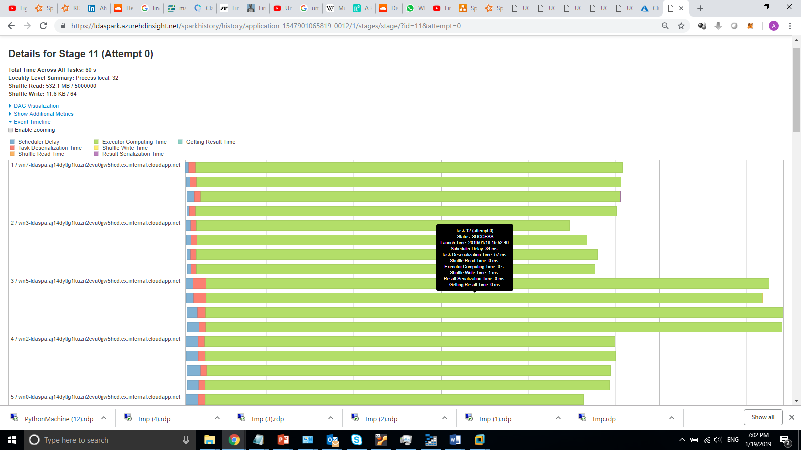
Distributing jobs from Train Function (3)
A sample stage of one job, it shows that computation is distributed between nodes, each bar represent processing a data partitions by worker node processor

Slide 29
LDA Result
5

Slide 30
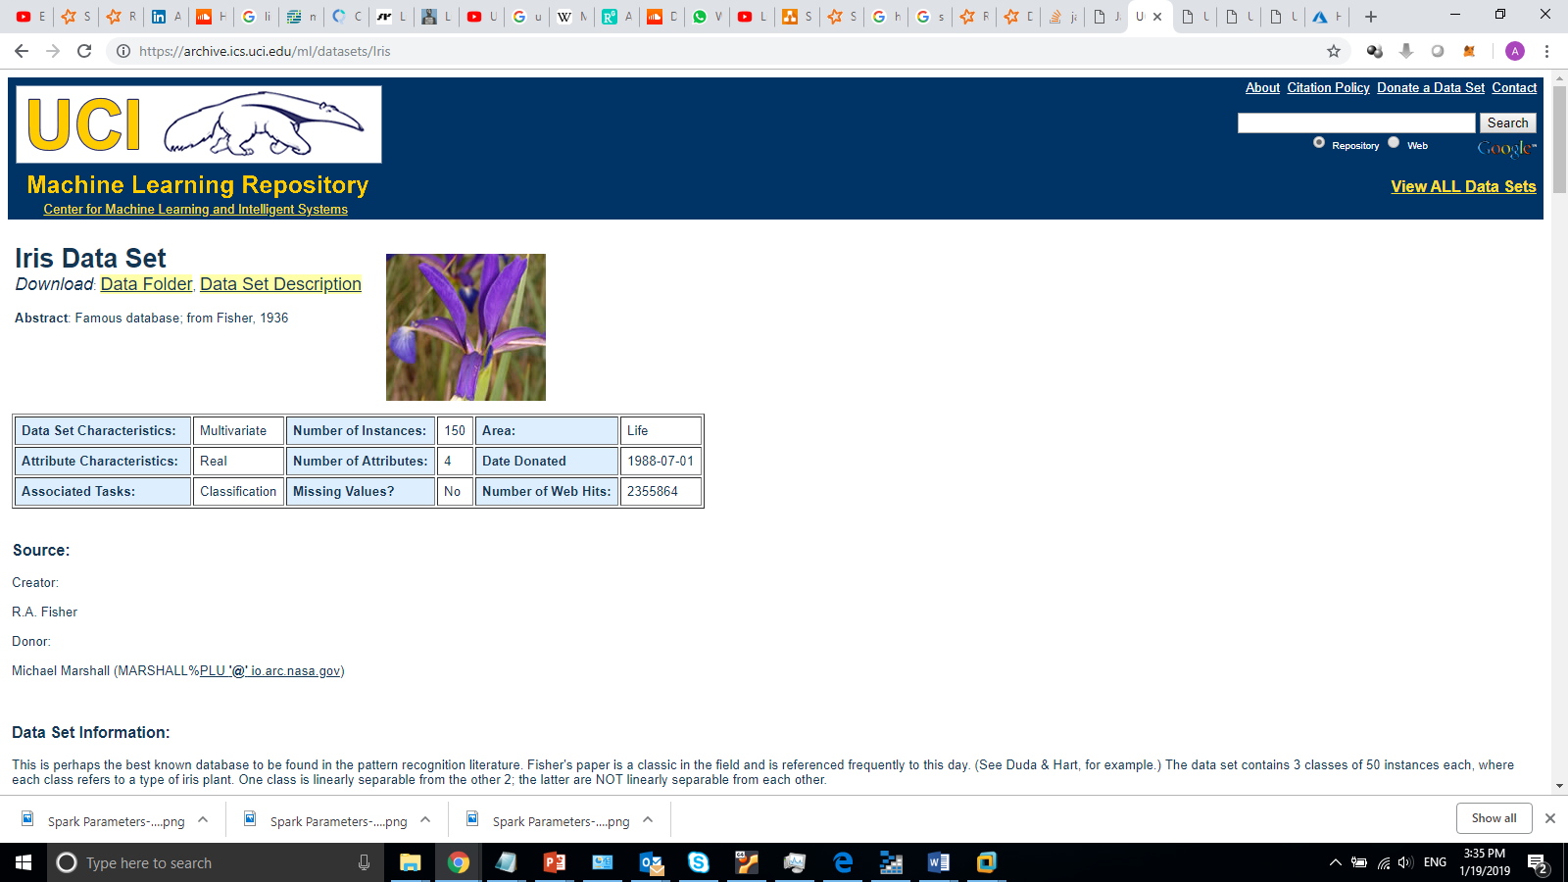
Example One
Iris Data Set
Result Statistics
Accuracy = 0.984375
Precision (0.0) = 1.0
Precision (1.0) = 0.9545454545454546
Precision (2.0) = 1.0
Time: 45 Second

Slide 31
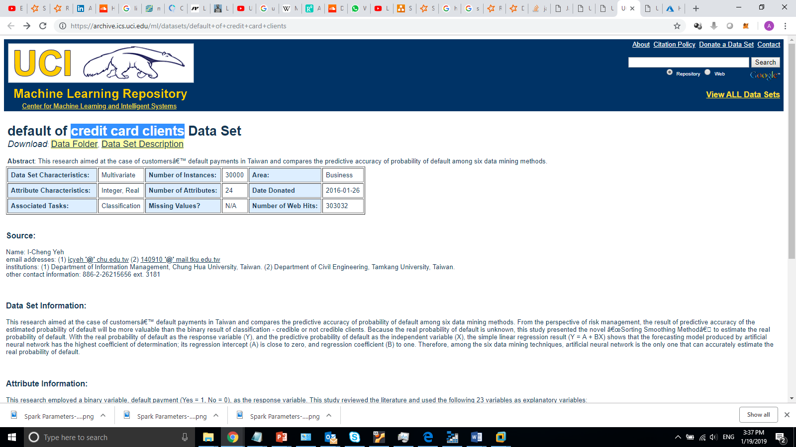
Example Two
Credit Card Clients
Result Statistics
Accuracy = 0.984375
Precision (0.0) = 1.0
Precision (1.0) = 0.9545454545454546
Precision (2.0) = 1.0
Time: 45 Second

Slide 32
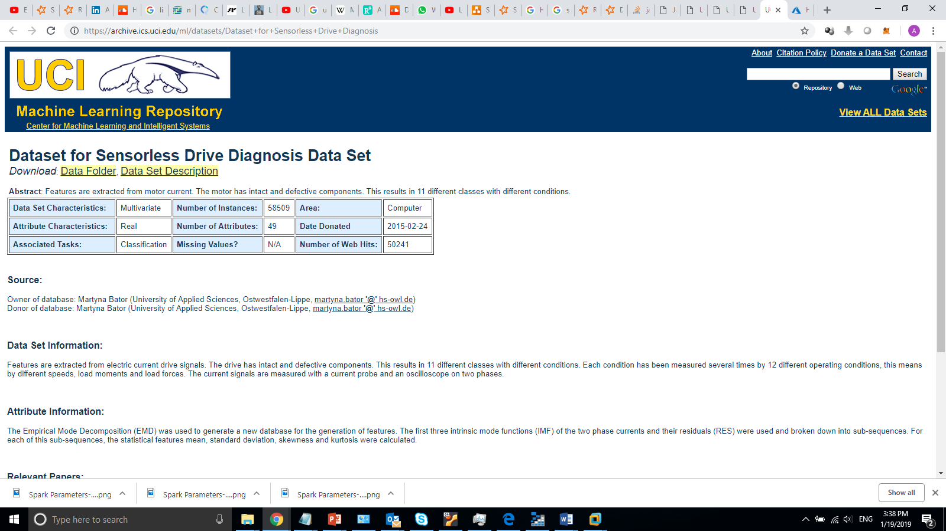
Example Three
Sensor less Drive Diagnosis
Result Statistics
Accuracy = 0.8146944083224967
Precision (0.0) = 0.9207547169811321
Precision (1.0) = 0.44862518089725034
Time: 40 Second

Slide 33
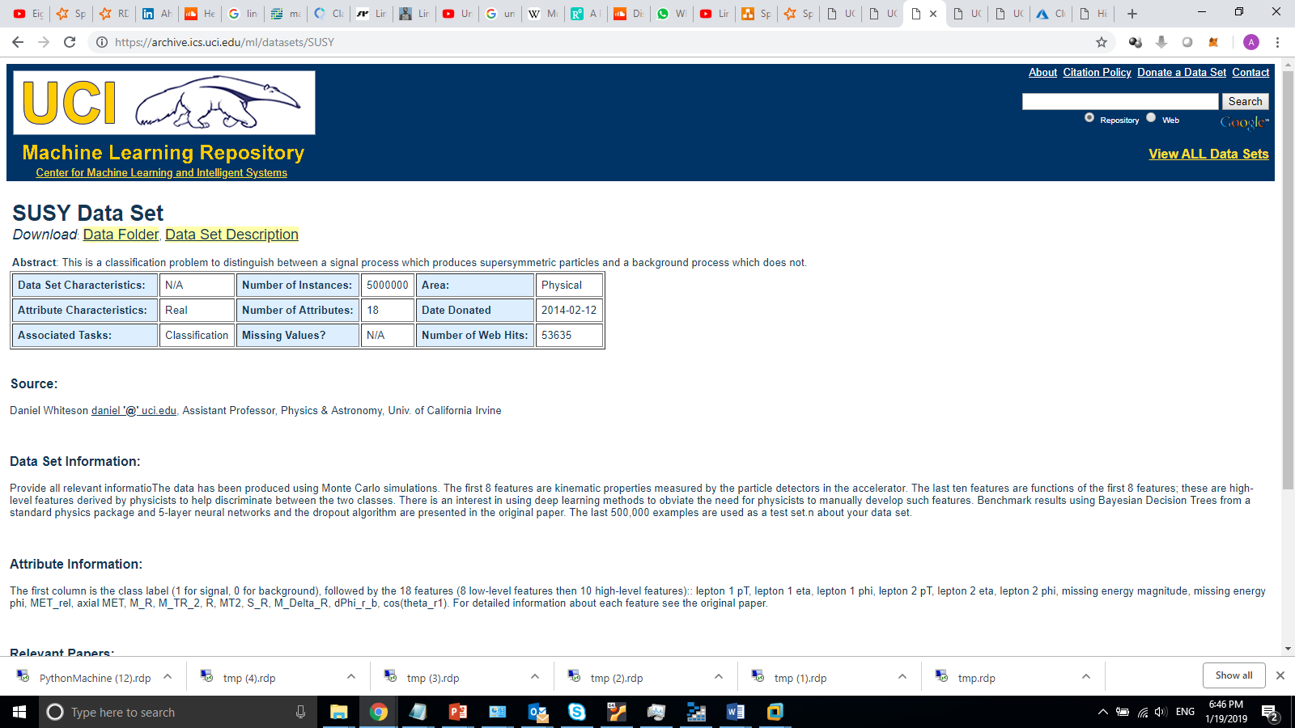
Example Four
SUSY Dataset
Result Statistics
Accuracy = 0.7621754610553266
Precision (0.0) = 0.8955602490159733
Precision (1.0) = 0.6045069266827867
Time: 5 minutes

Slide 34
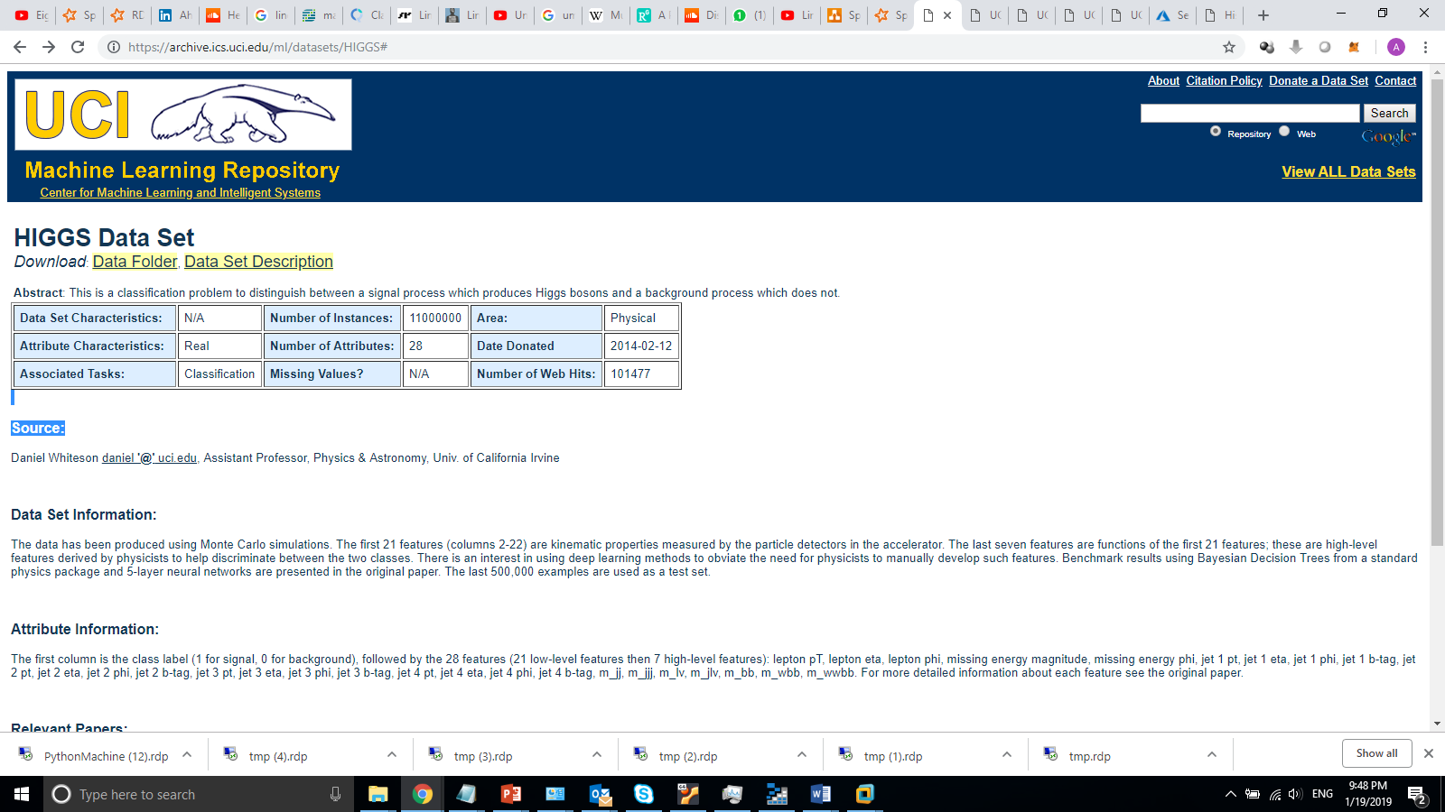
Example Five
HIGGS Dataset
Result Statistics
Accuracy = 0.6389403524884008
Precision (0.0) = 0.5706670536448508
Precision (1.0) = 0.6994716324071175
Time: 4.4 Minutes

Slide 35
Next…
Error and Data Type problem Handling
Write and load the Model
Check QDA implementation
Implement Scale parameters
Documentation

Slide 36
References
Multi- Collinearity
https://en.wikipedia.org/wiki/Multicollinearity
LDA
https://www.researchgate.net/publication/316994943_Linear_discriminant_analysis_A_detailed_tutorial
https://towardsdatascience.com/classification-part-2-linear-discriminant-analysis-ea60c45b9ee5
https://sebastianraschka.com/Articles/2014_python_lda.html
https://www.isip.piconepress.com/publications/reports/1998/isip/lda/lda_theory.pdf
http://www.mghassany.com/MLcourse/pw-4.html#linear-discriminant-analysis-lda
http://uc-r.github.io/discriminant_analysis
https://stat.ethz.ch/education/semesters/ss2012/ams/slides/v6.1.pdf

Slide 37
References
Spark Matrices and vectors
https://spark.apache.org/docs/2.2.0/mllib-data-types.html
SVD
https://en.wikipedia.org/wiki/Singular_value_decomposition
pseudoinverse
https://en.wikipedia.org/wiki/Moore%E2%80%93Penrose_inverse
Multivariate Gaussians
http://cs229.stanford.edu/section/more_on_gaussians.pdf
Eigen Vectors
https://textbooks.math.gatech.edu/ila/eigenvectors.html

